Slide 1
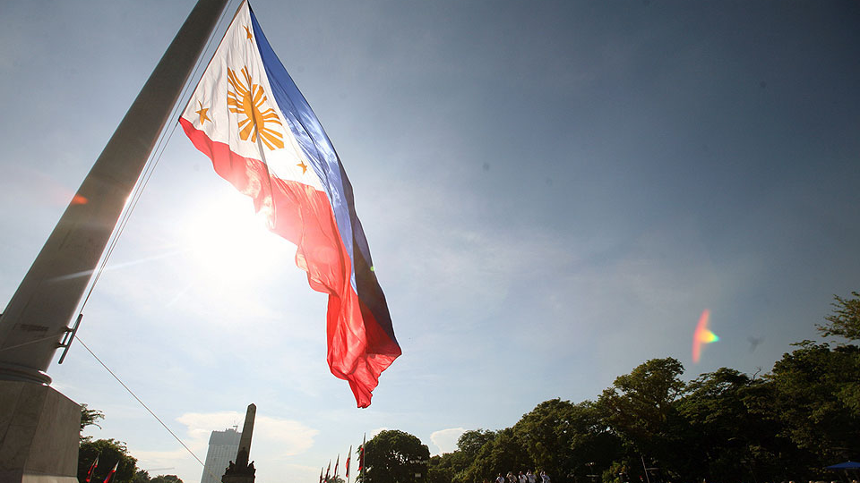
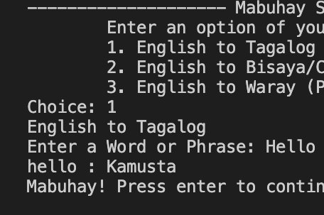
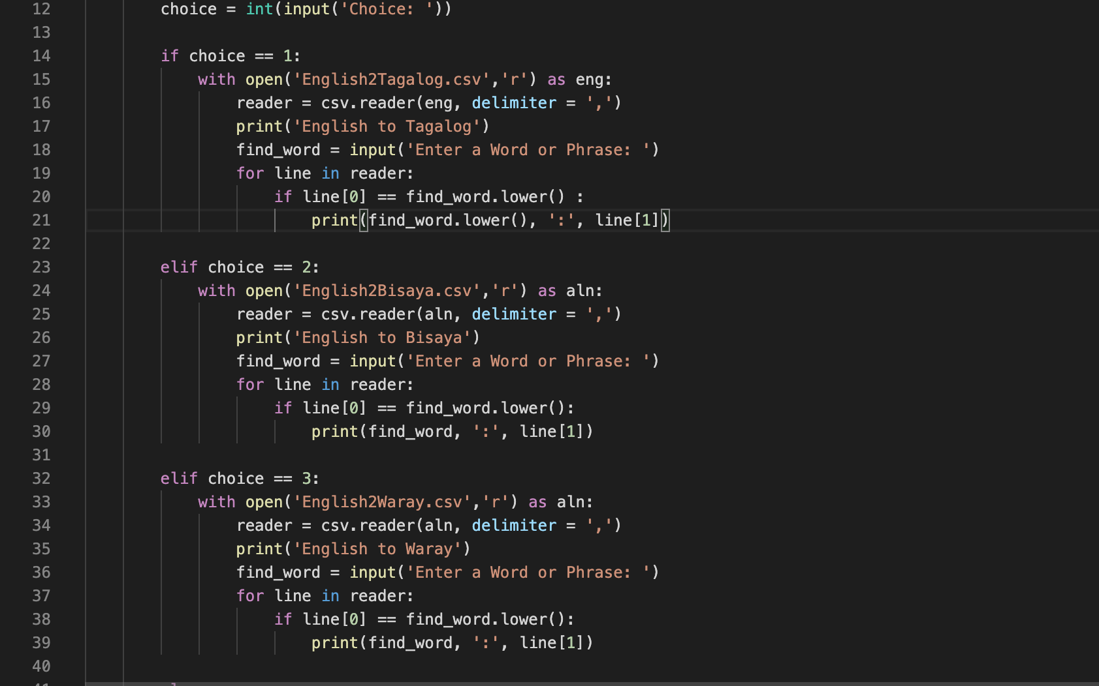

So Filipino
Translates from English to 3 widely spoken dialects in the Philippines
Including Tagalog and Bisaya
A Translator by Ryan Bacarra
https://github.com/ksu-is/So-Filipino-interpreter

Slide 2

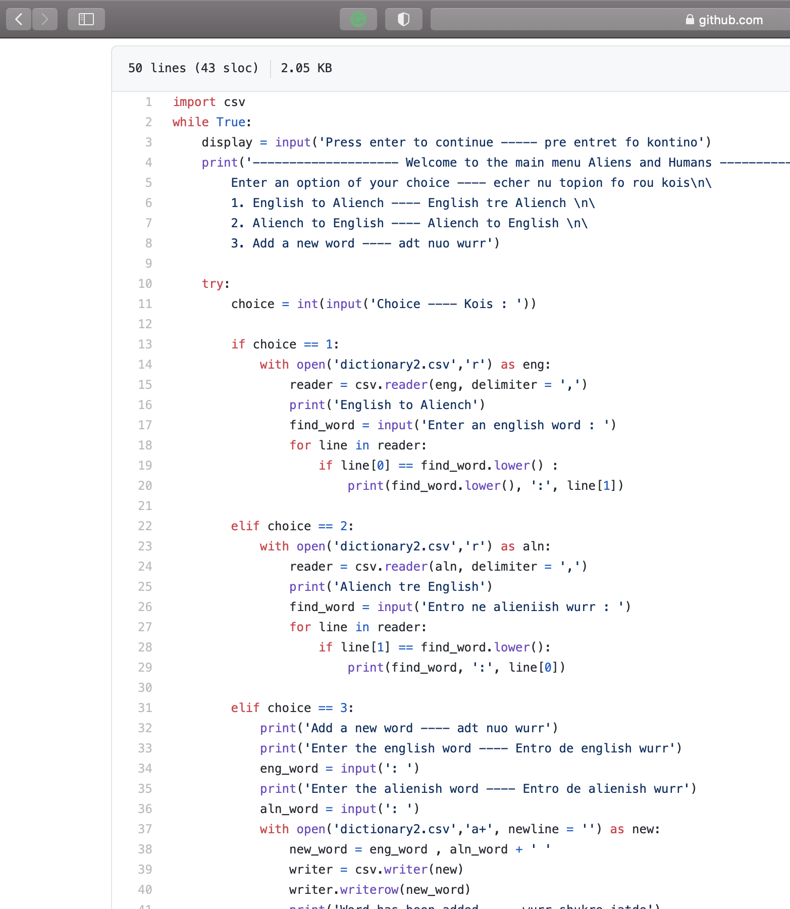
Ang Ideya – The Idea
A translator for foreigners visiting the Philippines
Experience and immersion
Tagalog, Cebuano/Bisaya, Waray
Alien-Human Translator by laibanasir on GitHub

Slide 3
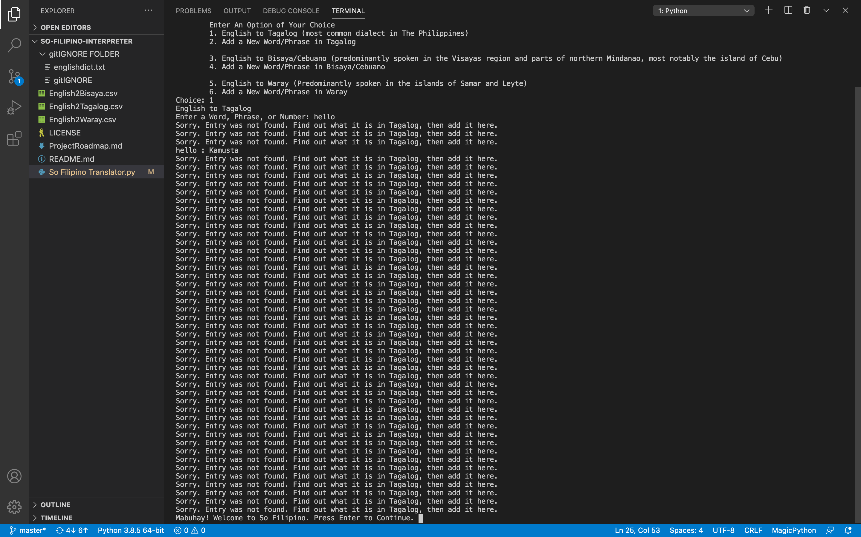

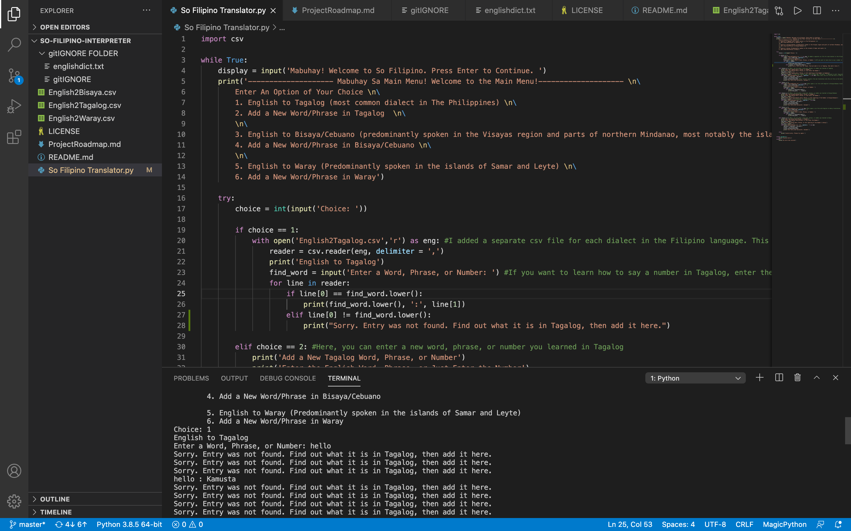
Surprises and Difficulties
2 translator modules;
One module per dialect?!
Tedious Part: Created csv modules for each dialect
Not many roadblocks, but there were some minor ones

Slide 4
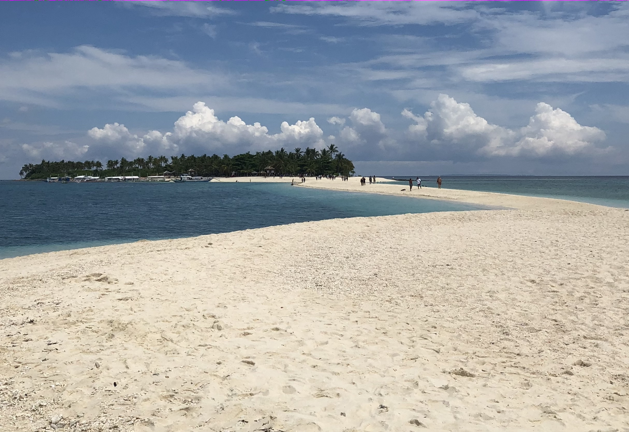
What’s Next?
“Sorry. Entry was not found. Find out what it is, then add it here.”
From dialects to English
Translators b/w dialects and English
B/w most-all dialects and other languages

